Slide 1
Gauging NY Mental Health Through Covid-19 Tweets
Clarissa Solis, Oviya Adhan, Robin Zhao
Notes:
clarissa

Slide 2
Overview
Dataset:
Covid-19 Tweets for the US from March 2020 - April 2021 IEEE
Goal:
Compare rates of depression related tweets, anxiety related tweets, and Covid Infection Rates in New York state
Notes:
oviya

Slide 3
Rationale
We want to compare rates of “depression” , “anxiety” related tweets and Covid infection numbers in New York
Why: It is well known that people’s mental health quality declined during the Covid-19 pandemic. We want to explore whether that is reflected in social media.
Hypothesis: Instances of depression and anxiety related tweets are positively correlated with increasing Covid-19 cases.
Notes:
clarissa

Slide 4
Method
Original dataset: two columns (tweet id, sentiment score)
Twitter API, request info for each Tweet (Tweet content, location, number of retweets, number of likes, datetime)
Clean Data: NY State, mental-health related
NLTK (tokenization, stopword removal, lemmanization)
Identify sentiments through depression keywords
Compare sentiments to COVID-19 cases
Statistical Tests (Granger Causality)
Notes:
robin

Slide 5
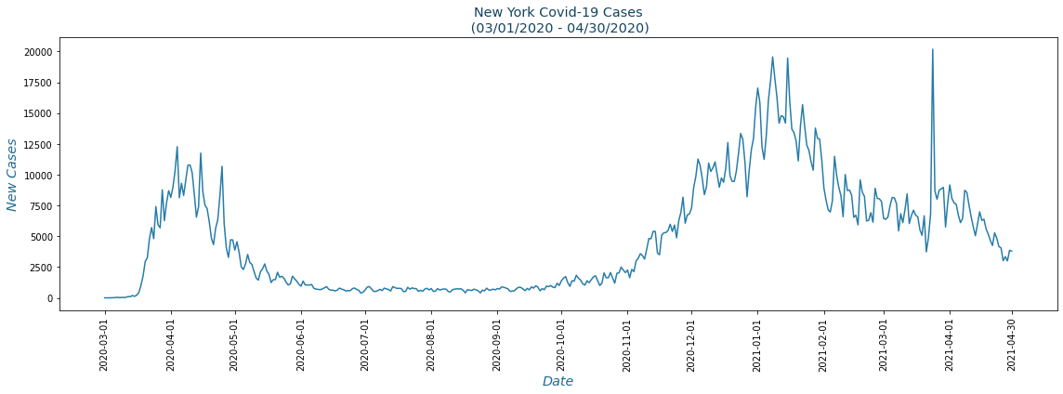
Results
No results yet; testing our hypothesis through the methods mentioned previously
Notes:
oviya
plotting keyword occurrences and sentiment levels
granger causality → test hypothesis

Slide 6
Questions?
Notes:
questions

